Slide 1




Design and Implementation of Hybrid and Native Communication Devices for Java HPC
Authors:
  Bibrak Qamar¹
  Ansar Javed¹
  Mohsan Jameel¹
  Aamir Shafi¹
  Bryan Carpenter²
¹School of Electrical Engineering and Computer Science
National University of Sciences and Technology, Pakistan
²School of Computing, University of Portsmouth, UK

Slide 2
Agenda
Introduction to MPJ Express:
  MPJ Express
  Java HPC
  MPJ Express Configurations
  MPJ Express Architecture
  Contributions of this Paper
Native Device
Hybrid Device
Performance Evaluation
Summary

Slide 3
Introduction to MPJ Express
MPJ Express is an MPI-like library that supports execution of parallel Java applications:
  http://mpjexpress.org
    The Java Grande Forum—formed in late 90s—came up with an API called mpiJava 1.2
      MPJ Express implementations this API
Motivation for a new Java messaging system:
  Maintain compatibility with Java threads by providing thread-safety
  Handle contradicting issues of high-performance and portability
  Requires no change to the native standard JVM
Notes:
MPJ Express is thread safe Message Passing System in Java. It is based on MPI Like standard mpiJava 1.2.
MPJ Express provides two modes of message passing. One is multicore modes. This mode developed for Shared memory and multicore processors. It is build on Java threads and these threads acts as MPJ Express processes and communicate through high speed shared memory communication mechanism.
Second mode is known as cluster mode. In this mode is based on Distributed Memory parallelism. All parallel processes are distributed and communication is done by message passing over the network.
This mode provides two network devices. One is niodev that is built on Java New IO technology and it work on TCP/IP.
Second device is mxdev that is built for high speed Myrinet interconnect.

Slide 4

Why Java
Portability
A popular language in colleges and software industry:
  Large pool of software developers
  A useful educational tool
Higher programming abstractions including OO features
Improved compile and runtime checking of the code
Automatic garbage collection
Support for multithreading
Rich collection of support libraries
Hadoop: A successful Java based distributed computing platform.

Slide 5




Communication Devices in MPJ Express
MPJ Express Modes
Cluster mode
Multicore mode
Cluster mode
Multicore mode
Java NIO
Java Threads
Myrinet Express
Native MPI library
InfiniBand

Slide 6


Other MPI Libraries for Java
FastMPJ is a proprietary implementation of mpiJava 1.2 API with following communication devices:
  Ethernet
  SMP
  Myrinet
  InfiniBand
Open MPI has introduced Java Bindings using JNI
  Uses Open MPI as native MPI library

Slide 7
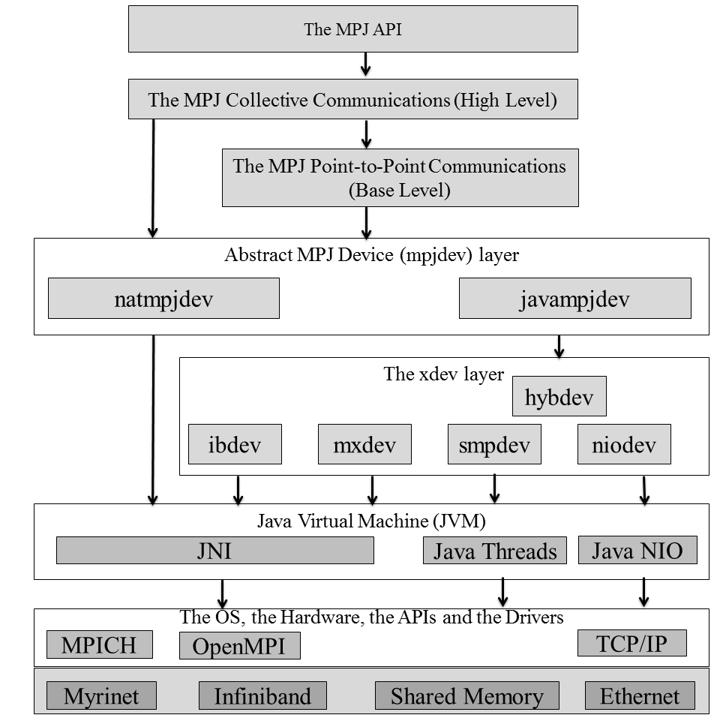
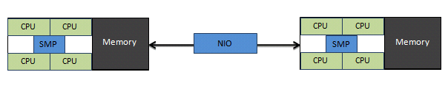
Contributions of this Paper
Native Device helps exploit native MPI library from parallel Java applications
  Offloads bulk of communication logic to native MPI library
  Native MPI libraries are optimized by vendors for their particular system
Hybdev helps transparently exploit hybrid parallelism in clusters made of multicore processors
  User need not worry about changing application code
  Shared memory communication for intra-node and network communication for inter-node
MPJ Express layered Architecture

Slide 8
Agenda
Introduction to MPJ Express
Native Device:
  Motivation
  Design
  Point-to-Point & Collective Communication
Hybrid Device
Performance Evaluation
Summary

Slide 9
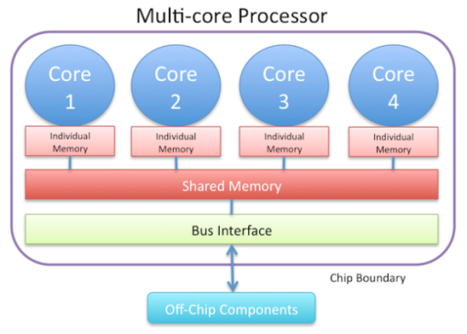
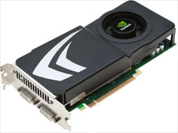
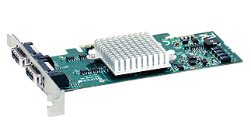
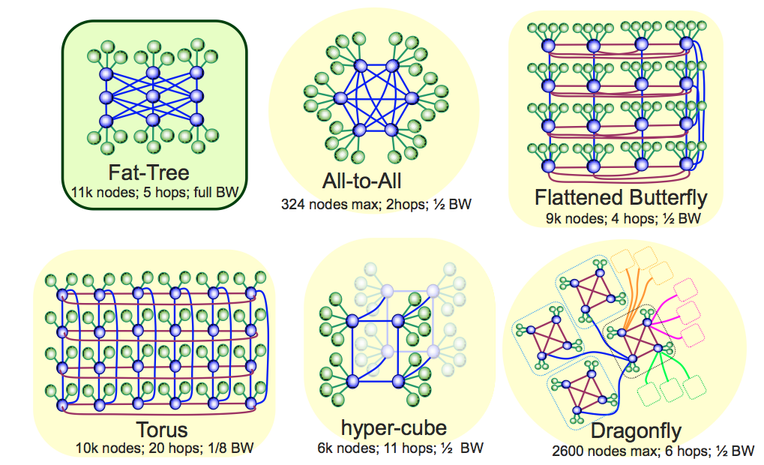
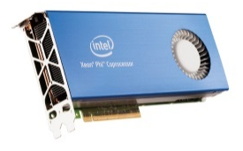
Motivation for Native Device
MPICH and Open MPI have faster development cycles:
  Efficient collective communication
  MPI 3.0 Compliant
  Support for HPC interconnects
Offload messaging to native MPI library
Network Topologies
Multi-Core Processors
High-Speed Interconnect
Like, InfiniBand
Co-Processors
Like, GPUs, Phi

Slide 10
Native Device for MPJ Express
Native Device is inspired by mpiJava library developed by one of the co-author ( Bryan Carpenter)
Native Device enables MPJ Express to use native MPI libraries for communication.
Native Device uses JNI to talk to native MPI implementations:
MPJ Express
JNI
C MPI

Slide 11
Native Device Point-to-Point Communication
P1
P2
Send(buf, offset, count, datatype, dest, tag)
Recv(buf, offset, count,
datatype, source, tag)
Allocated outside JVM memory
Allocated outside JVM memory
Intermediate buffering
using ByteBuffer
Intermediate buffering
using ByteBuffer
natmpjdev (native device)
natmpjdev (native device)
JNI
JNI
Native MPI library
Native MPI library
MPI_Send(buf, count, datatype, dest, tag, comm)
MPI_Recv(buf, count, datatype, source, tag, comm, status)
Network

Slide 12
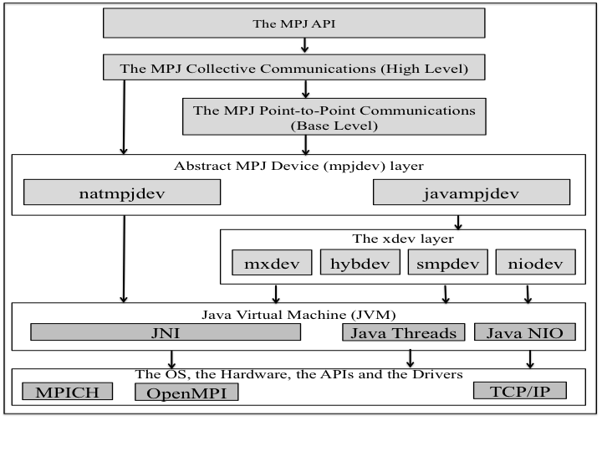
Native Device Collective Communications
Native Device uses collective communication routines of the native MPI library
  This is interesting because MPJ Express can exploit collective communication routines optimized by vendors for their target system
Native Device can also be configured to use MPJ Express’ collective communication algorithms

Slide 13
Agenda
Introduction to MPJ Express
Native Device
Hybrid Device:
  Motivation
  Design
  Point-to-Point Communication
Performance Evaluation
Summary

Slide 14
Hybrid Device for MPJ Express—Motivation
Modern clusters are built with nodes having multicore processes.
Efficiently harnessing their computational power requires Distributed and Shared memory parallelism to work together
Modular approach with flexibility to use any network device
  Currently, Hybrid Device integrates niodev and smpdev device
Java support for Hybrid Memory system
 | Transparent | Non-Transparent
Non-Standard API | Parallel Java (Threads + Message Passing) | JESSICA2, Jackal, cJVM, Pleiad
Standard API | MPJ Express Hybrid device | MPJ + JOMP, MPJ + Java threads

Slide 15

Hybrid Device Design
Hybrid Device Design
Two possible design options for Hybrid device
Custom Build Device
Pluggable Device
xdev layer
xdev layer
hybdev
hybrid device
niodev
Network Communication
Shared Memory Communication
smpdev
Select any of the Network Devices
niodev
mxdev
smpdev

Slide 16
Hybrid Device – Message Passing
Point-to-Point Communication
For message passing Hybrid device uses
  Use smpdev for intra-node communication
  Use niodev for inter-node communication
Source | Destination | Data
00a | 00d | 1133
Rank | PID | NetID
0 | 00a | 0
1 | 00b | 0
2 | 00c | 0
3 | 00d | 0
4 | 00e | 1
5 | 00f | 1
6 | 0a0 | 1
7 | 0b0 | 1
Message is for local process
Node 0
Node 1
1133
P0
P1
P4
P5
smpdev
niodev
smpdev
P2
P3
P6
P7

Slide 17
Hybrid Device – Message Passing
For message passing Hybrid device uses
  Use smpdev for intra-node communication
  Use niodev for inter-node communication
Source | Destination | Data
00b | 0a0 | 3366
Rank | PID | NetID
0 | 00a | 0
1 | 00b | 0
2 | 00c | 0
3 | 00d | 0
4 | 00e | 1
5 | 00f | 1
6 | 0a0 | 1
7 | 0b0 | 1
Message is for remote host process
Node 0
3366
Node 1
P0
P1
P4
P5
smpdev
niodev
smpdev
P2
P3
P6
P7

Slide 18
Agenda
Introduction to MPJ Express
Native Device
Hybrid Device
Performance Evaluation:
  Point-to-Point Communication
  Collective Communication
  Java NAS Parallel Benchmarks
  Java Gadget 2
Summary

Slide 19
Point-to-Point Communication
Latency across Gigabit Ethernet
Bandwidth across Gigabit Ethernet
Latency across InfiniBand
Bandwidth across InfiniBand

Slide 20
Collective Communication
Bcast() (128 Cores GigaBit Ethernet)
Bcast() (128 Cores InfiniBand)

Slide 21
Java NAS Parallel Benchmark
IS (Class C)
CG (Class C)
FT (Class C)
EP (Class C)

Slide 22


Java Gadget-2
Gadget-2 is a cosmological N-body/SPH simulation that runs on massively parallel computers with distributed memory.
We have implemented a Java version of Gadget-2 using MPJ Express

Slide 23
Performance Evaluation using Java Gadget-2
Cluster Simulation 276498 Particles
Execution time in Minutes of Java Gadget-2

Slide 24
Agenda
Introduction to MPJ Express:
Native & Hybrid Devices
Performance Evaluation
Summary

Slide 25
Summary
MPJ Express is an MPI-like library that supports execution of parallel Java applications
Two new communication devices presented
  Native Device
    Exploits a native MPI library to execute Parallel Java programs.
    Uses innovations and advancements of the native MPI library.
  Hybrid Device
    Transparently exploits hybrid parallelism using Shared Memory device and a Network Communication device.
    Pluggable design to use any network device for inter-node communication.

Slide 26
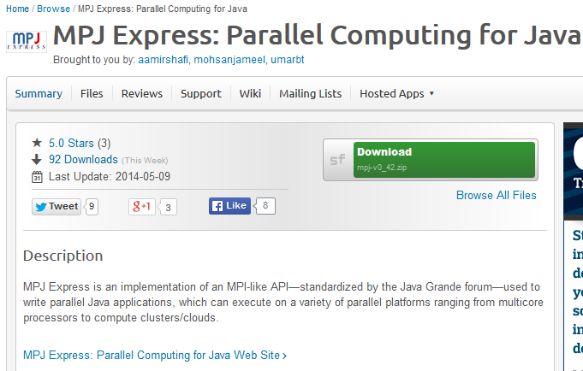














Questions? http://mpjexpress.org

