Slide 1



High Performance Message Passing Infiniband Communication Devices for Java HPC
Authors:
Omar Khan
Mohsan Jameel
Aamir Shafi
School of Electrical Engineering and Computer Science (SEECS)
National University of Sciences and Technology, (NUST) Pakistan

Slide 2
Agenda
Introduction to MPJ Express:
MPJ Express
Java HPC
MPJ Express Configurations
MPJ Express Architecture
Contributions of this Paper
InfiniBand Device
Performance Evaluation
Summary

Slide 3
Introduction to MPJ Express
MPJ Express is an MPI-like library that supports execution of parallel Java applications:
http://mpjexpress.org
The Java Grande Forum—formed in late 90s—came up with an API called mpiJava 1.2
MPJ Express implements this API
Motivation for a new Java messaging system:
Maintain compatibility with Java threads by providing thread-safety
Handle contradicting issues of high-performance and portability
Requires no change to the native standard JVM
Notes:
MPJ Express is thread safe Message Passing System in Java. It is based on MPI Like standard mpiJava 1.2.
MPJ Express provides two modes of message passing. One is multicore modes. This mode developed for Shared memory and multicore processors. It is build on Java threads and these threads acts as MPJ Express processes and communicate through high speed shared memory communication mechanism.
Second mode is known as cluster mode. In this mode is based on Distributed Memory parallelism. All parallel processes are distributed and communication is done by message passing over the network.
This mode provides two network devices. One is niodev that is built on Java New IO technology and it work on TCP/IP.
Second device is mxdev that is built for high speed Myrinet interconnect.

Slide 4

Why Java
Portability
A popular language in colleges and software industry:
Large pool of software developers
A useful educational tool
Higher programming abstractions including OO features
Improved compile and runtime checking of the code
Automatic garbage collection
Support for multithreading
Rich collection of support libraries
Hadoop: A successful Java based distributed computing platform.

Slide 5




Communication Devices in MPJ Express
MPJ Express Modes
Cluster mode
Multicore mode
Cluster mode
Multicore mode
Java NIO
Java Threads
Myrinet Express
Native MPI library
InfiniBand

Slide 6
InfiniBand Support in Java
No direct support in Java to fully exploit InfiniBand.
Currently relies on TCP/IP emulation for communication over IB network
For Giga-bit Ethernet, bandwidth and latency performance of Java nearly the same as that of C .
Java Runtime and Java TCP/IP stacks are well optimized
Comparable with C/C++ in network Intensive I/O
For InfiniBand, the TCP/IP emulation layers show poor performance.
SDP and IPoIB are example of ULP’s (Upper Layer Protocols)
 | IB Verbs | SDP | IPoIB
API | Low level | Socket (TCP only) | Socket
Latency | Lowest | Lower | Low
Bandwidth | Highest | High | Medium
CPU utilization | Lowest | High | highest
Kernel bypass | ✓ | ✗ | ✗
ULP overhead | Light | Medium | High
Memory registration | Explicitly by application/ middleware | Heuristics by SDP | None
Application adaptation | Porting/development required | Supports unmodified application

Slide 7


Other MPI Libraries for Java
FastMPJ is a proprietary implementation of mpiJava 1.2 API with following communication devices:
Ethernet
SMP
Myrinet
InfiniBand
Open MPI has introduced Java Bindings using JNI
Uses Open MPI as native MPI library

Slide 8
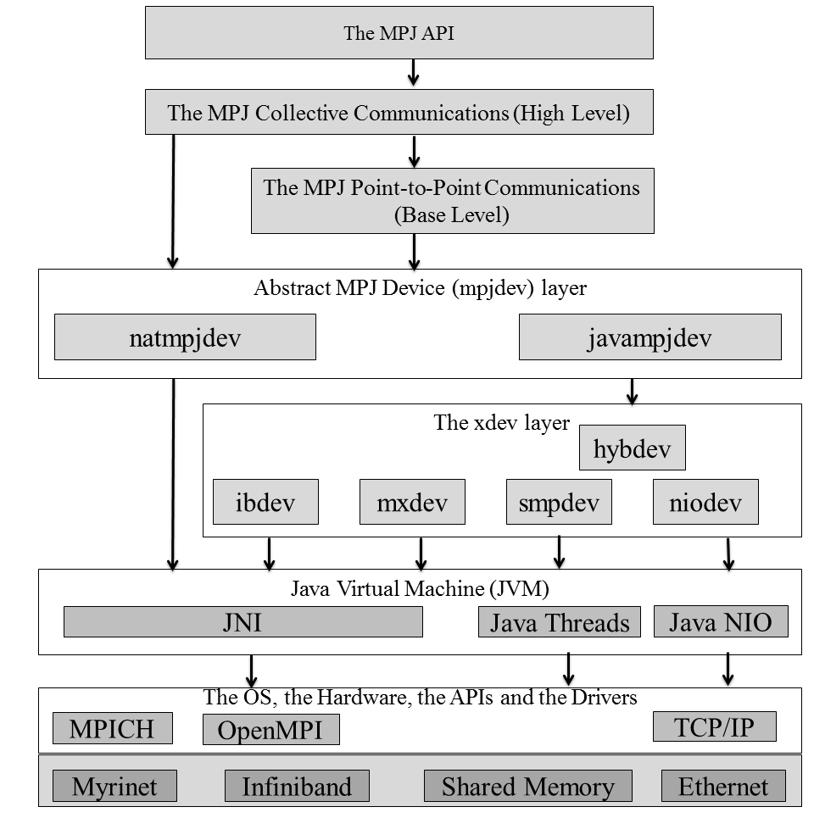
Contributions of this Paper
Ibdev bypass the TCP/IP emulation laryer by directly interfacing with IB Verbs API through Java Native Interface
Offload communication to the InfiniBand Hardware
Avoids extra overhead introduced by TCP/IP emulation incurred by ULPs
MPJ Express layered Architecture

Slide 9
Agenda
Introduction to MPJ Express
InfiniBand Device:
Design
Functionality
Point-to-Point Communication
Performance Evaluation
Summary

Slide 10
ibdev – InfiniBand Device for MPJ Express
InfiniBand device in xdev layer
Java Native Interface (JNI) wrapper to access low level native code
Each method of ibdev delegates on a native function
xdev layer
Java
ibdev
JNI
IBV C Library
C
libibverbs + librdmacm
InfiniBand Hardware

Slide 11
ibdev – Native C library
Built on top of Verbs API
Implements a set of low-level communication primitives, which are in turn used by the higher layers
Connected Transport Service
Reliability
Delivery order
Data loss detection
Error detection
xdev layer
Java
ibdev
JNI
IBV C Library
C
libibverbs + librdmacm
InfiniBand Hardware

Slide 12

ibdev - Native C library - Initialization
Connection manager is used to setup connection between all processes.
Set of Queue Pair QP (Send and Recv Queues) and a Completion Queue CP are created for evey connection at each process.
Example of three processes initialization
QP
CQ
QP
CQ
Connection Request
Send
Recv
Send
Recv
QP
CQ
QP
CQ
Send
Recv
Send
Recv
P0
Accept Connection
P1
Device Initialized
InfiniBand Device
InfiniBand Device
InfiniBand Device
InfiniBand Device
Accept Connection
Accept Connection
Connection Request
Connection Request
QP
CQ
QP
CQ
Send
Recv
Send
Recv
P2
InfiniBand Device
InfiniBand Device

Slide 13
Point to Point Communication
Memory registered for CM
Memory registered for CM
Processor
Processor
Memory Segment
Memory Segment
Memory Segment
Memory Segment
Registered Send Buffer
Registered Receive Buffer
Communication Completed
CQ
QP
QP
CQ
Send
Recv
Send
Recv
InfiniBand Device
InfiniBand Device
Sender
Receiver
Registers send buffer
Sends MSG_MR CM to receiver
Tag, context, buffer length
Registers memory buffers
Sends MSG_RDY CM containing memory keys to sender
RDMA write to remote memory
Gets control message from sender
Gets remote keys of the receive buffer in control message

Slide 14
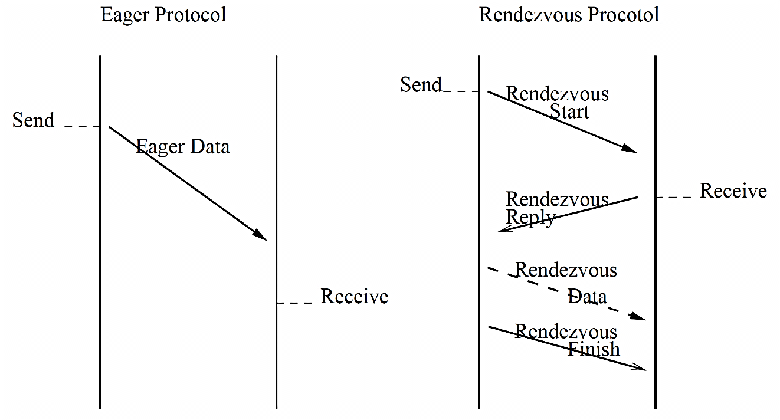
Communication Protocols
Registration of buffer prior to communication
Involves OS and NIC
Expensive operation
Eager protocol
Small messages < 128K
Avoid buffer registration
Pool of pre-registered buffers
Rendezvous protocol
Large messages > 128K
Buffer pinned on the fly
Unregistered after use
Remote keys exchanged via control messages

Slide 15
Agenda
Introduction to MPJ Express:
InfiniBand Device
Performance Evaluation:
Point-to-Point Communication
Java NAS Parallel Benchmarks
Conclusion and Future Work

Slide 16
Point-to-Point Latency
Latency in µsec

Slide 17
Point-to-Point Bandwidth

Slide 18
Java NAS Parallel Benchmark
CG Kernel (Class C)
FT Kernel (Class C)
IS Kernel (Class C)

Slide 19
Agenda
Introduction to MPJ Express:
InfiniBand Device
Performance Evaluation
Summary

Slide 20
Summary
Java message passing libraries should focus on low level communication devices for high speed interconnects.
Transparently provides MPJ Express with efficient performance on InfiniBand.
High performance because relies on native verbs to take advantage of RDMA support.

Slide 21















Questions? http://mpjexpress.org

