Slide 1

Programming Parallel Hardware using
MPJ Express
Aamir Shafi
ashafi@mit.edu

Slide 2





Contributors
Aamir Shafi
Jawad Manzoor
Kamran Hamid
Mohsan Jameel
Rizwan Hanif
Amjad Aziz
Bryan Carpenter
Mark Baker
Hong Ong
Guillermo Taboada
Sabela Ramos

Slide 3
Programming Languages in the HPC World
HPC programmers have two choices for writing large-scale scientific applications:
  Support parallelism by using message passing between processors using existing languages like Fortran, C, and C++
  Adopt a new HPC language that provides parallelism constructs (for e.g UPC)
The first approach led to the development of the Message Passing Interace (MPI) standard:
  Bindings for Fortran, C, and C++
  Interest in developing bindings for other languages like Java:
    The Java Grande Forum—formed in late 90s—came up with an API called mpiJava 1.2

Slide 4
Why Java?
Portability
A popular language in colleges and software industry:
  Large pool of software developers
  A useful educational tool
Higher programming abstractions including OO features
Improved compile and runtime checking of the code
Automatic garbage collection
Support for multithreading
Rich collection of support libraries

Slide 5

MPJ Express
MPJ Express is an MPI-like library that supports execution of parallel Java applications
Three existing approaches to Java messaging:
  Pure Java (Sockets based)
  Java Native Interface (JNI)
  Remote Method Invocation (RMI)
Motivation for a new Java messaging system:
  Maintain compatibility with Java threads by providing thread-safety
  Handle contradicting issues of high-performance and portability
  Requires no change to the native standard JVM

Slide 6
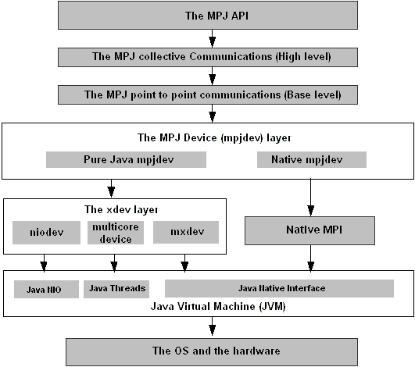
MPJ Express Design

Slide 7
“Hello World” MPJ Express Program
1 import mpi.*;
2
3 public class HelloWorld {
4
5 public static void main(String args[]) throws Exception {
6
7 MPI.Init(args);
8 int size = MPI.COMM_WORLD.Size();
9 int rank = MPI.COMM_WORLD.Rank();
10
11 System.out.println("I am process <"+rank+">");
12
13 MPI.Finalize();
14 }
15 }
aamirshafi@velour:~/work/mpj-user$ mpjrun.sh -np 4 HelloWorld
MPJ Express (0.38) is started in the multicore configuration
I am process <1>
I am process <0>
I am process <3>
I am process <2>

Slide 8
An Embarrassingly Parallel Toy Example
Master Process
Worker 0
Worker 1
Worker 2
Worker 3

Slide 9
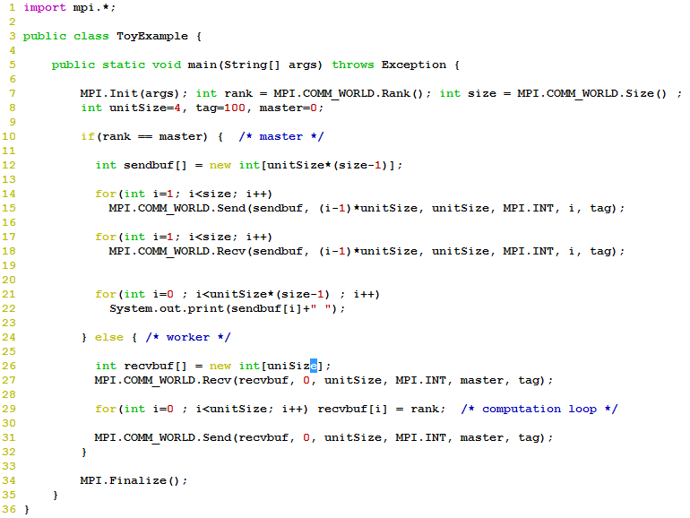
aamirshafi@velour:~/work/mpj-user$ mpjrun.sh -np 5 ToyExample
MPJ Express (0.38) is started in the multicore configuration
1 1 1 1 2 2 2 2 3 3 3 3 4 4 4 4

Slide 10
Outline of the Presentation
MPJ Express:
  Thread-safe point-to-point communication
  Collective communication
  Memory management
  The runtime system
A case study from computational astrophysics
Summary

Slide 11
Point-to-point Communication
 | Standard | Synchronous | Ready | Buffered
Blocking | Send() Recv() | Ssend() | Rsend() | Bsend()
Non-blocking | Isend() Irecv() | Issend() | Irsend() | Ibsend()
Non-blocking methods return a Request object:
  Wait() //waits until communication completes
  Test() //test if the communication has finished

Slide 12
“Blocking”
Sender
Receiver
Send()
Recv()
CPU waits
CPU waits
time
“Non Blocking”
Sender
Receiver
Isend()
Irecv()
CPU does
computation
CPU does
computation
time
Wait()
Wait()
CPU waits
CPU waits

Slide 13
Thread-safe Communication
Thread-safe MPI libraries allow communication from multiple user threads inside a single process
Such an implementation requires fine-grain locking:
  Incorrect implementations can deadlock
Levels of Thread-Safety in MPI Libraries
MPI_THREAD_SINGLE
MPI_THREAD_FUNNELED
MPI_THREAD_SERIALIZED
MPI_THREAD_MULTIPLE ☺

Slide 14
Implementation of point-to-point communication
Various modes of blocking and non-blocking communication primitives are implemented using two protocols
Eager Send
Rendezvous

Slide 15


Implementation of sockets communication device
Process 0
Process 1
← Send Queues →
← Recv Queues →
Non-blocking
Blocking

Slide 16
Eager Protocol (two cases)
Sender
First Case
Receiver
isend
irecv
Time ->
Time ->
Message received directly in the user buffer
Sender
Second Case
Receiver
isend
Time ->
Time ->
Message received in a temporary buffer before being copied to user buffer
irecv

Slide 17
Myrinet and Multithreaded Comm Devices
MPJ Express works over Myrinet by proving JNI wrappers to the Myrinet eXpress library
The software also runs in the multithreaded mode where each MPJ process is represented by a thread inside a single JVM
Proc 0
CPU 0
Proc 3
Main Memory
Proc 1
CPU 3
CPU 1
CPU 2
Proc 2

Slide 18
Performance Evaluation of Point to Point Communication
Normally ping pong benchmarks are used to calculate:
  Latency: How long it takes to send N bytes from sender to receiver?
  Throughput: How much bandwidth is achieved?
Latency is a useful measure for studying the performance of “small” messages
Throughput is a useful measure for studying the performance of “large” messages
RTT!
Node A
Node B

Slide 19
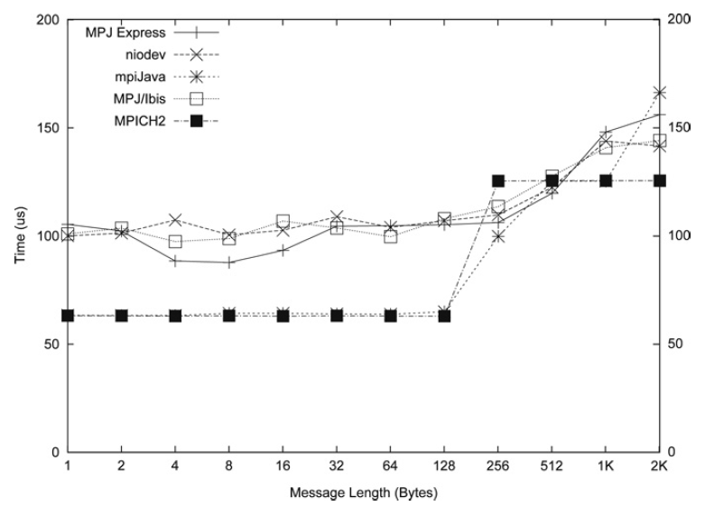
Latency Comparison on GigE

Slide 20
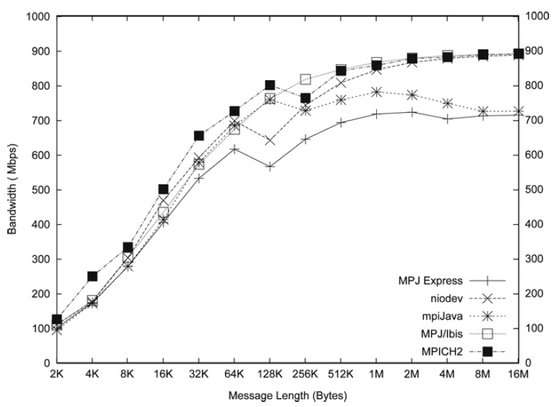
Throughput Comparison on GigE

Slide 21
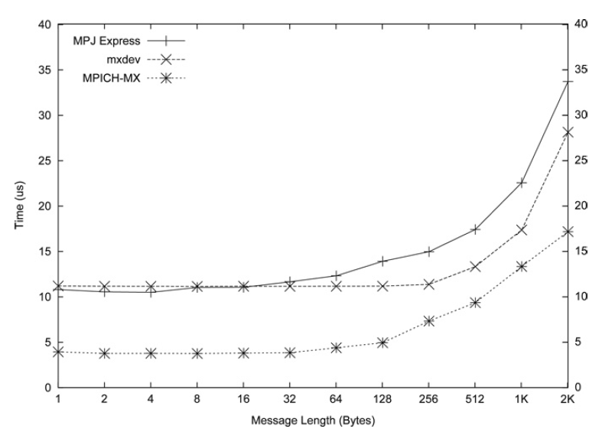
Latency Comparison on Myrinet

Slide 22
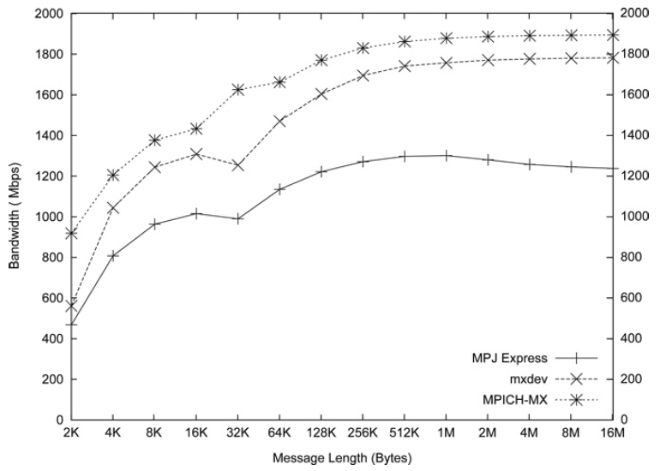
Throughput Comparison on Myrinet

Slide 23
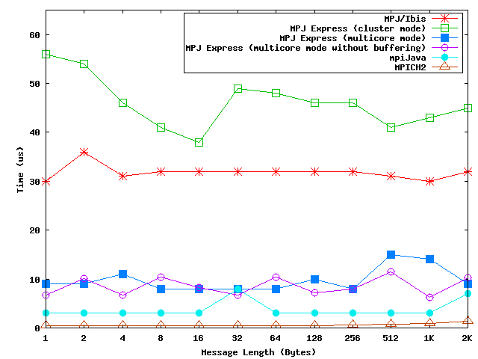
Latency Comparison on a multicore machine

Slide 24
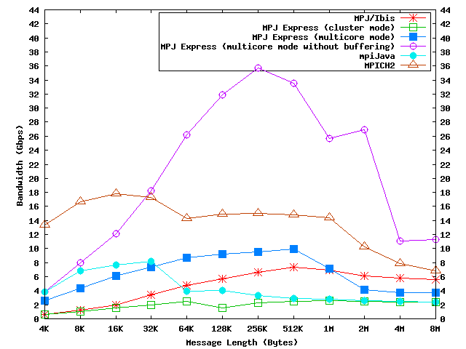
Throughput Comparison on a multicore machine

Slide 25
Collective communications
Provided as a convenience for application developers:
  Save significant development time
  Efficient algorithms may be used
  Stable (tested)
Built on top of point-to-point communications

Slide 26
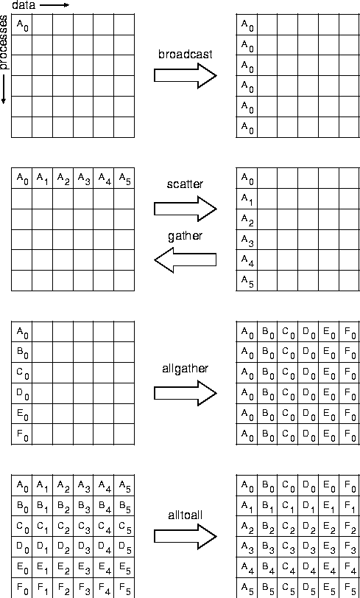
Image from MPI standard doc

Slide 27
Reduce collective operations
Processes
MPI.PROD
MPI.SUM
MPI.MIN
MPI.MAX
MPI.LAND
MPI.BAND
MPI.LOR
MPI.BOR
MPI.LXOR
MPI.BXOR
MPI.MINLOC
MPI.MAXLOC

Slide 28
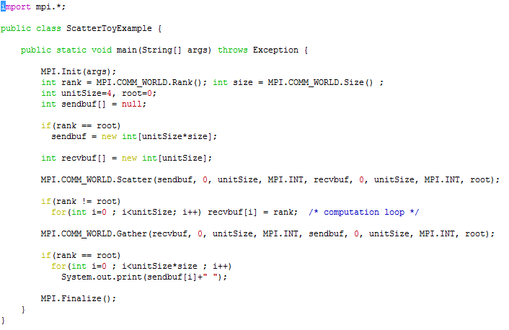
Toy Example with Collectives

Slide 29
Barrier with Tree Algorithm
7

Slide 30
Alternate Barrier Implementation

Slide 31
Broadcasting algorithm, total processes=8, root=0
7

Slide 32
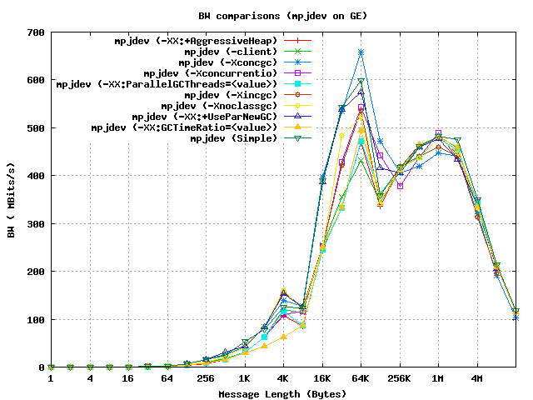
Memory Management in MPJ Express
MPJ Express explicitly manages memory for internal usage
Each Send()and Recv()method internally creates a buffer:
  Such constant creation of buffers can be detrimental

Slide 33
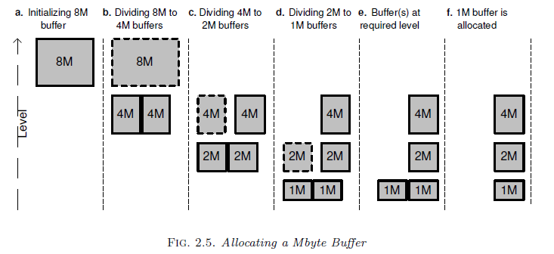
Review of Buddy Algorithm

Slide 34
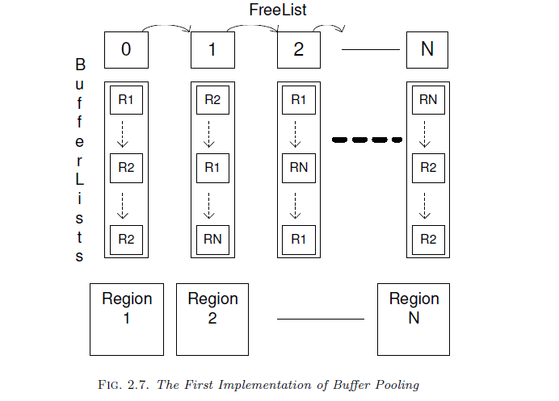
A buffer pooling strategy implemented

Slide 35
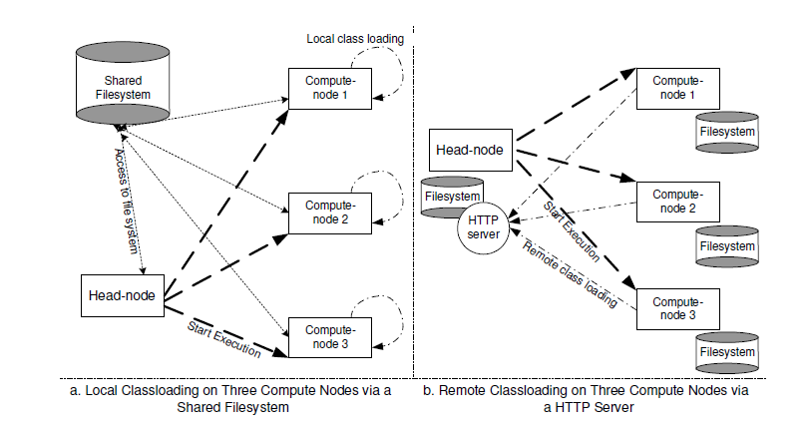
The Runtime System

Slide 36
Outline of the Presentation
MPJ Express:
  Thread-safe point-to-point communication
  Collective communication
  Memory management
  The runtime system
A case study from computational astrophysics
Summary

Slide 37
A Case Study from Computational Astrophysics
Various publications [BSPF01][FF97][NNS03][MMG00] suggest Java to be a good candidate for HPC
This argument does not convince many, perhaps due to scarcity of high-profile number-crunching codes in Java
Gadget-2 is a production-quality code for cosmological N-body (and hydrodynamic) computations:
  Written by Volker Springel, of the Max Plank Institute for Astrophysics, Garching

Slide 38
Porting Gadget-2 to Java
Dependencies on:
  MPI library for parallelization:
    Replace MPI calls with MPJ Express,
  GNU scientific library (but only a handful of functions):
    The required methods were hand translated to Java,
  FFTW – library for parallel Fourier transforms:
    Not needed because we disabled TreePM algorithm,
We have successfully run Colliding Galaxies and Cluster Formation example simulations:
  These use pure Dark Matter – hydrodynamics code not yet tested.

Slide 39
Java Optimizations
Initial benchmarking revealed that the Java code is slower by a factor of 2-3,
Custom serialization and de-serialization:
  Replacing Java object communication with primitive datatypes,
Flattening sensitive data-structures in the hope of exploiting processor cache efficiently,
  Many data structures were Java objects
Avoiding expensive array operations
Improved collective algorithms in MPJ Express
if(USE_P_OBJ_ARRAY) {
P[i].Pos[k] = LowerBound[k] + Range[k] * drandom;
P[i].Vel[k] = 0;
}
else {
P_doubles[(P_Po+PDS*i)+k] = LowerBound[k] + Range[k] * drandom;
P_doubles[(P_Ve+PDS*i)+k] = 0;
}

Slide 40
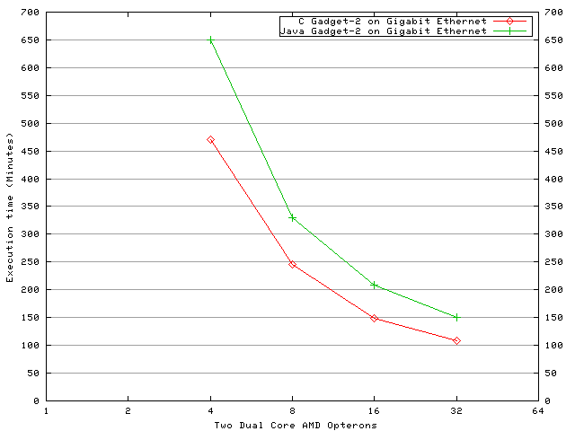
Execution Time for the Cluster Formation Simulation

Slide 41
Summary
MPJ Express (www.mpj-express.org) is an environment for MPI-like parallel programming in Java
It was conceived as having an expandable set of “devices”, allowing different underlying implementations of message passing
The software explicitly manages internal memory used for sending and receiving messages
We parallelized Gadget-2 using MPJ Express and managed to get good performance

Slide 42
Future Work
MPJ Express performance can be improved:
  Improving or removing the intermediate buffering layer (this layer implies additional copying)
  Develop JNI wrappers to native MPI libraries
Debugging and profiling tools for MPJ Express
Support for other high performance interconnects including Quadrics, Infiniband, and 10 GigE
A portable runtime system

Slide 43
References
[SCB09a] Shafi A., Carpenter B., Baker M.Nested parallelism for multi-core HPC systems using Java(2009) Journal of Parallel and Distributed Computing, 69 (6), pp. 532-545.
[SCB09b] Shafi A, Carpenter B, Baker M, and Hussain A, A Comparative Study of Java and C Performance in Two Large Scale Parallel Applications, Concurrency and Computation: Practice and Experience, pp 1882-1906, 21(15), October 2009
[BSPF01] Bull JM, Smith LA, Pottage L, Freeman R. Benchmarking Java against C and Fortran for Scientific Applications. ACM: New York, NY, U.S.A., 2001; 97–105.
[FF97] Fox GC, Furmanski W. Java for parallel computing and as a general language for scientific and engineering simulation and modeling. Concurrency: Practice and Experience 1997; 9(6):415–425.
[NNS03] Nikishkov GP, Nikishkov YG, Savchenko VV. Comparison of C and Java performance in finite element computations. Computers and Structures 2003; 81(24–25):2401–2408.
[MMG00] Moreira JE, Midkiff SP, Gupta M. From flop to megaflops: Java for technical computing. ACM Transactions on Programming Languages and Systems 2000; 22(2):265–295.
Notes:
[BSPF01][FF97][NNS03][MMG00]

